Slide 1
The Pandemic Pain is More Serious in Emerging Markets and Developing Countries: Causes and Remedies. Institution affiliation Student’s Name Date of Submission

Slide 2
Executive summary
This report discusses the impact of covid 19 on emerging markets and developing countries.
Government-imposed measures such as lockdowns, quarantines, trade restrictions and cessation of movements degraded the economic scale of countries and caused a global economic crisis.
The paper elaborates some of the areas affected as a result of covid 19 containment measures which include; the money market, production, and manufacturing sectors.
The report provides possible remedies for EMDEs that can be used to fight the pandemic as well as ensuring economic recovery after the pandemic.

Slide 3
The pandemic pain is more serious in emerging markets and developing countries: causes and remedies. Introduction
Most of the effects have been felt by the emerging markets and developing economies in the sub-Saharan countries.
Most of the EMDEs countries have experienced increased unemployment, reduction in working hours, temporary layoffs, high death rates, increased poverty, low savings, low investments, and reduced revenues to the government.
During this particular time, savings is one of the instruments used by people worldwide as part of financial security.
State governments, central banks as well as commercial banks use the same formula to shape their spending.

Slide 4
Causes
The Coronavirus has affected the financial markets and the world economy by interfering with businesses and organizational activities.
It has negatively affected income as a result of low productivity, remote working, and premature deaths.
Due to staggering economic activities, most of the EMDEs took loans to be used to fight the pandemic.
The projection shows that in 2021, the EMDEs' budgetary deficits are likely to double to almost 10.5% of their GDP averagely than in 2019.

Slide 5
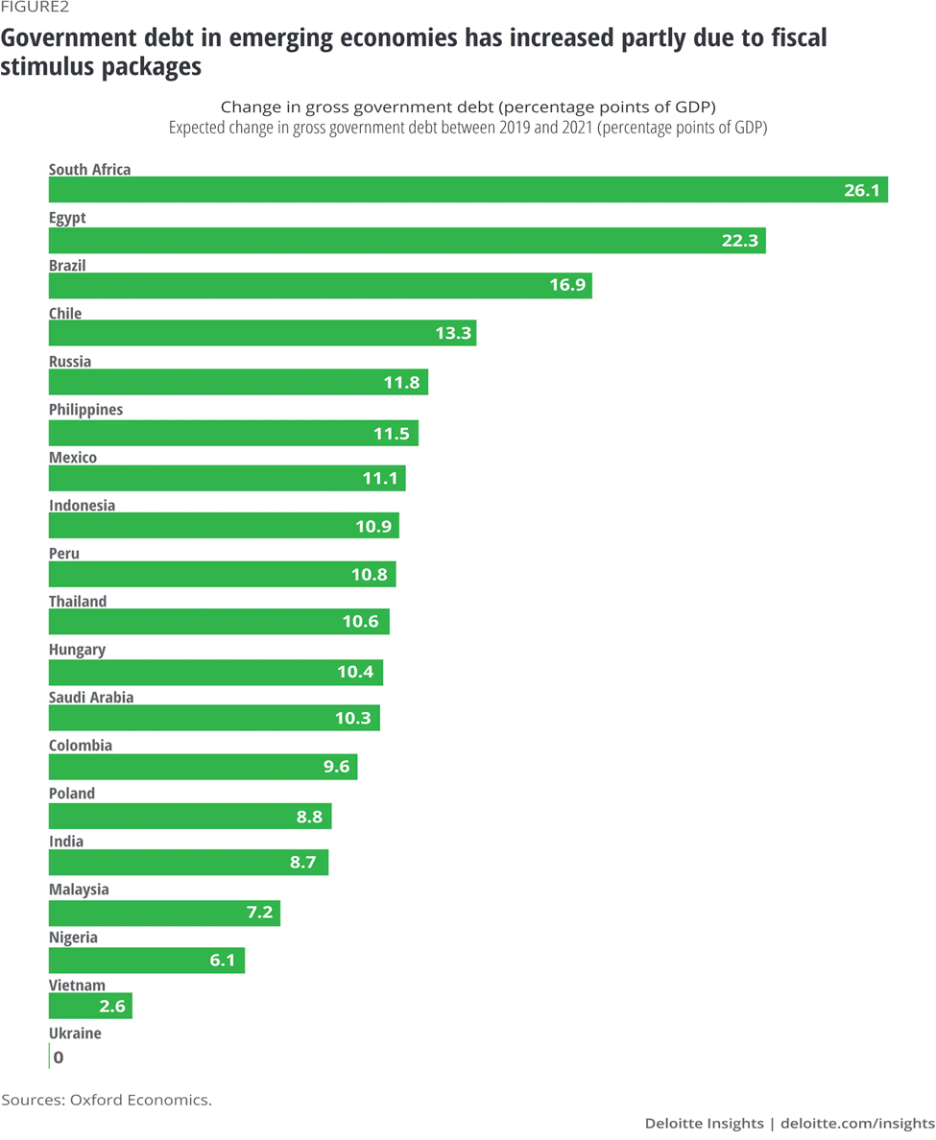
Increased public debt
Increase in public debt and pressure created by the coronavirus pandemic in emerging markets and developing countries have created a long-run crisis.
Government debts in EMDEs have dramatically increased due to fiscal stimulus packages.
Higher rate of government borrowing creates an impetus that stimulates private sectors that seeks extra financial support to cover internal costs during the pandemic.
Country's such as Thailand, Poland, Chile, and Brazil declared larger stimulus debt packages, and this means that they receive large debt gains in return.

Slide 6
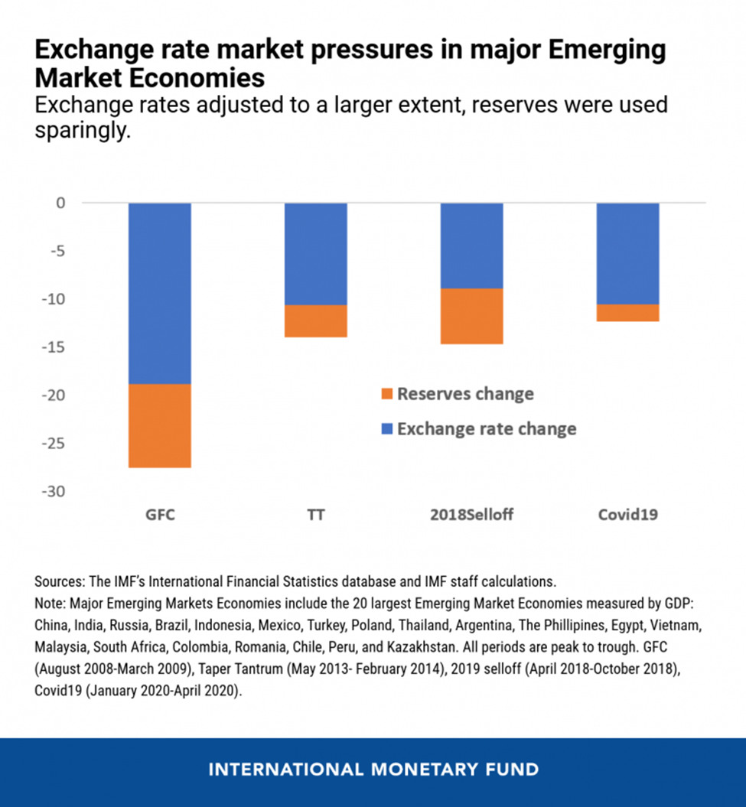
Market Exchange Rate in EMDEs
Most of the emerging markets' economies tightened their policies to prevent capital outflow to avoid inflation due to depreciation in the exchange rate.
Most of the emerging market economies use reserve barriers that allow adjustment to the exchange rate.
EMDEs countries injected liquidity to facilitate their market activities; for example, Poland and Indonesia eased some policies to support credit.
EMDEs should engage in massive exportation to the rest of the world for it to restore their economic growth by earning foreign exchange to repay their international debts.

Slide 7
The impact of imposed measures by the government
Government measures such as imposing lockdowns as a means of contending the spread of the virus have caused total disturbances in the supply chain due to the closure of factories.
Most of the production activities were halted and industries closed their operations. Since there was no supply, the demand for industrial products reduces dramatically.
Policies such as self-isolation and quarantine led to a massive reduction in consumption level, thus reducing the demand for goods and services.
This is because consumers were forced to change their spending habits due to low income and household.

Slide 8
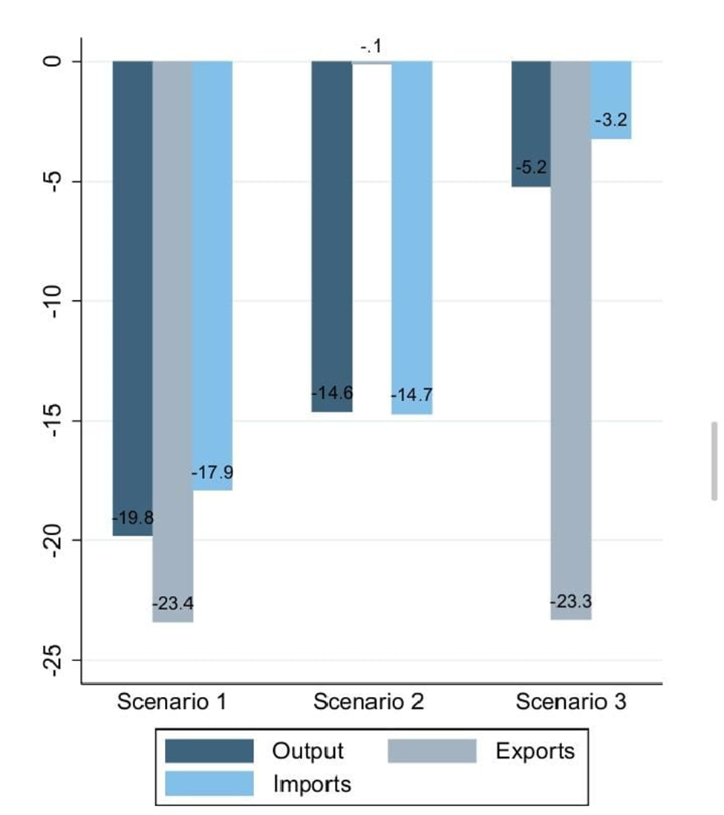
The role of external demand shocks without lockdown
A reduction in demand for foreign goods creates a total decline in the output of the domestic sector.
A reflection from the Turkish data presents a decline in automobiles by a certain percentage meaning there is a global decline for demand in automobiles across the world and, more so, EMDEs.
In figure 3, the exports declined by 23.4%; this was 5.5 more than the decline experienced in the imports, which was 17.9%.
This situation is more consistent with EMDEs countries because most of them depend on importing intermediate goods.

Slide 9
Investment and capital formation in EMDEs
The pandemic caused fluctuating prices of raw materials, especially the research and development institutions lacked modern equipment like machines, very high costs of production and seasonal employment.
In Pakistan, 14% of its GDP is expenditures on investment.10% for the private sector while 4% is for public investment.
Pakistan's main investment and capital formation in the past five years is seen to come from China-Pakistan Economic Corridor (CPEC).
Under lockdown, such coordination was disabled that worsened EMDEs which depended on other countries in terms of investments and capital formation.

Slide 10
Remedies
During this disquieting moment, EMDEs country's policymakers need to look for immediate response to contain health and the economic crisis.
In the long run, responsible authorities should employ comprehensive programs to propel economic growth drivers .
Policies that strengthen the health system and the available impetus that stimulate economic growth should be rebuilt both in the short and long term.
These impetuses include; supporting private sectors and distributing funds directly to other businesses.

Slide 11
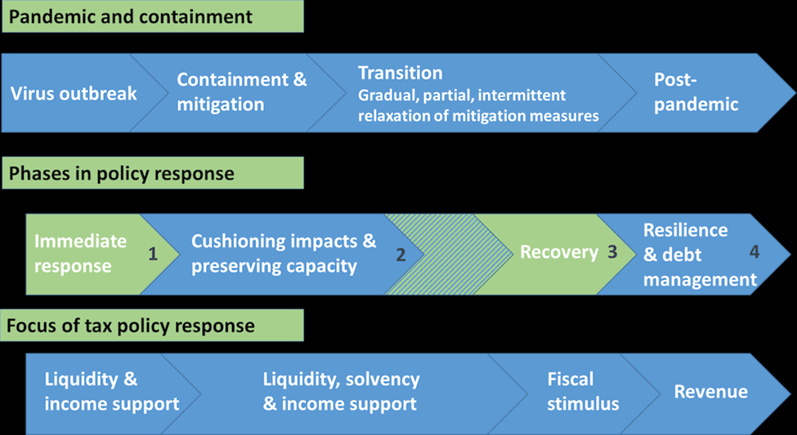
Schematic policy phases during and after the pandemic
Figure 4 provides an overview of possible procedures that EMDEs countries' tax policies can support their economies through the pandemic.
The suggestions are structured in a systematic layout based on tax policy and how the pandemic and various policy responses may be implemented.
At first, the EMDEs and other advanced economies should observe containment and mitigations to stop the pandemic's outbreak.
This is a temporary stage that depends on the medical care and health system's level together with support from the population response.

Slide 12
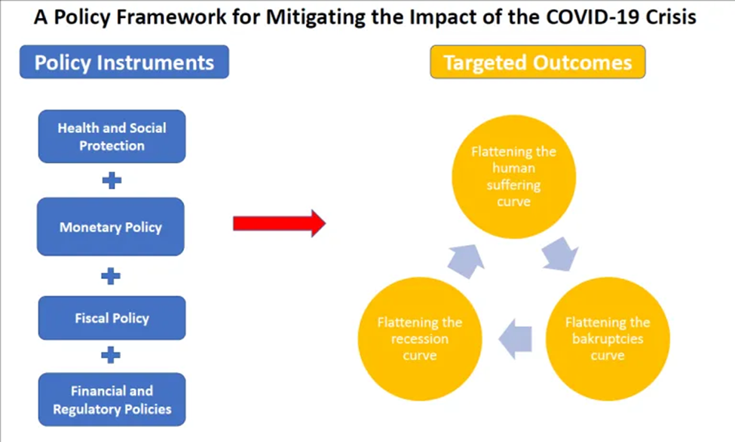
EMDEs policy frameworks for mitigating economic impact of covid 19
EMDEs countries should focus on sustaining economic activities by supporting households, essential services, and firms.
EMDEs should use monetary, fiscal, and financial policies to support households' income, employment, and firm cash flows to reduce the pandemic's economic scars.
These policies should be favorable and flexible because of the lockdown's unpredictable nature and slow economic recovery.

Slide 13
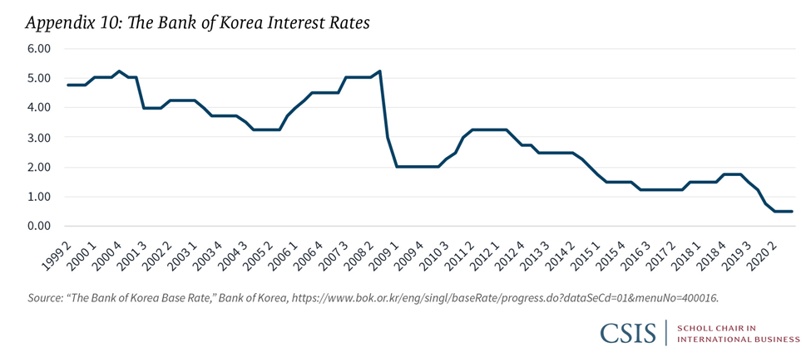
Monetary policy
EMDEs countries should cut down their policy rates and provide liquidity to solvent banks.
BOK reduced interest rates from 1.25% to almost 0.5%.
The BOK reduced the collateral requirement for net settlements in the payment system to easy purchases of treasury bonds.
Other monetary policies that should be put in place by the EMDEs include; financial stability plan that focuses on expanding financial support to firms and companies.

Slide 14
Response to fiscal policy
EMDEs should come up with effective supplementary budgets that cater for “disease prevention and treatment, loans and guarantees for business affected, support for households affected, and support for local economies affected.
EMDEs should lay down a formula for progressive tax to achieve equity in the tax pay rate.
Most EMDEs countries should waive specific levies on airlines and tourism sectors because the pandemic hard hits them.
They should also reduce standard VAT rates to create room for people to save and invest.

Slide 15
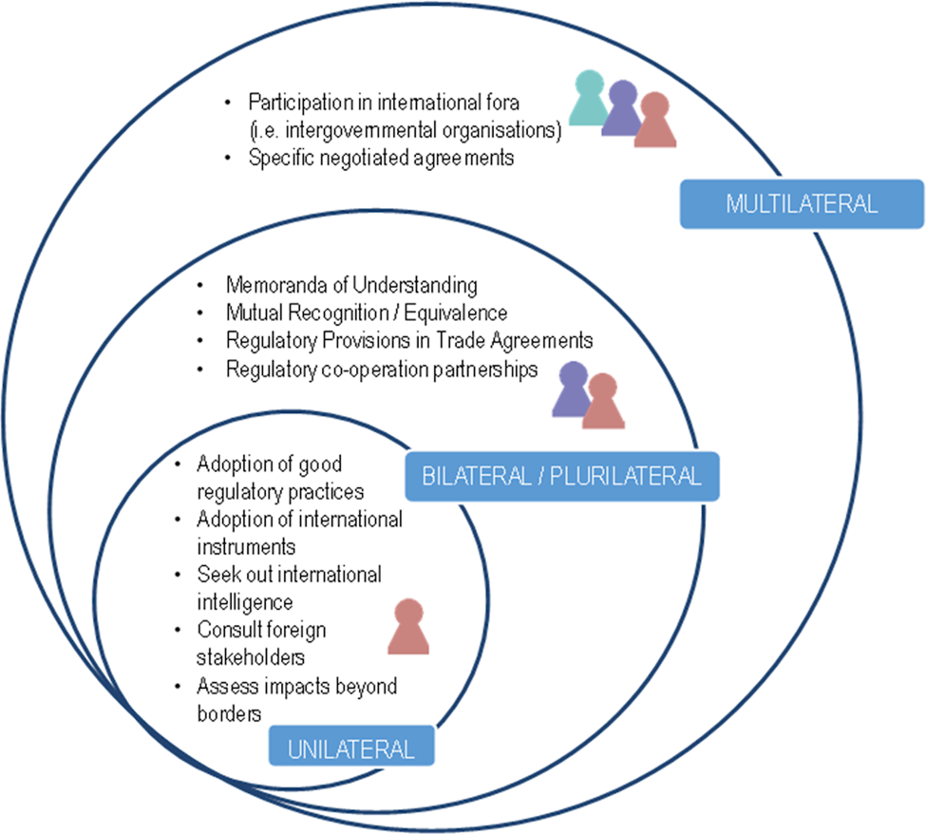
Engaging in global coordination and cooperation
EMDEs should seek international support that can provide a positive approach that can be used to achieve public health goals and a substantial economic growth.
By engaging in global coordination and cooperation, EMDEs countries will be able to use the three approaches including the multilateral approach where they will participate in intergovernmental organizations and engage in negotiable agreements.
Through the bilateral approach, EMDEs will have mutual recognition through partnership with other countries.

Slide 16
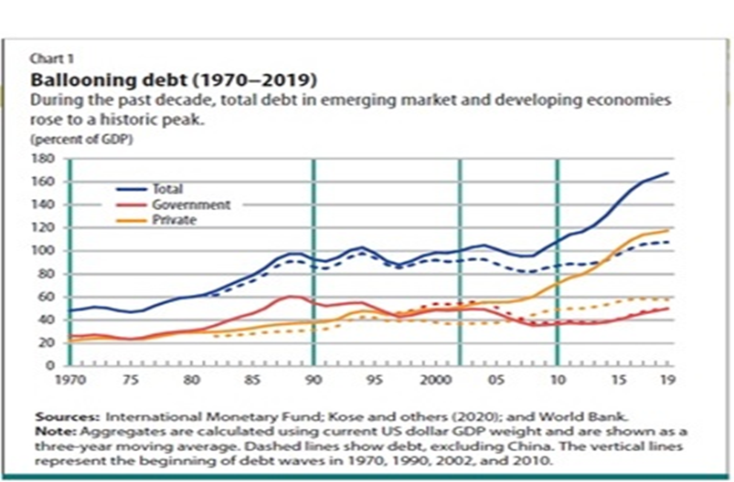
Reducing public debt
Reducing public debt, especially by the EMDEs government, would reduce the cost of living during the pandemic.
Even before the emergence of the pandemic, EMDEs had accumulated substantial public debts.
Since 2010, EMDEs total debt increased by 60% of the GDP, recording a historic peak of more than 170% of GDP in 2019.
Governments should be on the look to find alternative solutions for the current high borrowing as a source of finance to support in fighting the pandemic.

Slide 17
Conclusion
The Emerging Markets Developing Economies have felt the coronavirus pain more greatly than the developed countries.
There are still opportunities to improve the crisis by reimagining privatization regulation, social protection, ensuring National reconciliation, equity, and maintaining a sustainable the environment.
There is a great need to tighten the health system of the EMDEs and implement the remedies to support sustainable growth and development once the pandemic abates.

